Slide 1


CMR TECHNICAL CAMPUS
UGC(Autonomous)
Kandlakoya,Medchal Road,Hyd-501 401 Department of Computer Science Engineering
Major Project On
MULTI CLASS STRESS DETECTION THROUGH HEART RATE VARIABILITY
BATCH NO : 08
Project Guide: BATCH MEMBERS:
Saba Sultana 217R1A05G1 KOPPULA VARSHINI
Assistant Professor, CSE Department 217R1A05F0 JANGALA POOJITHA
217R1A05E4 DARAMALLA DAYANIDHI
Project Coordinator:
K.Shilpa
Assistant Professor, CSE Department

Slide 2
CONTENTS
Abstract
Introduction
Existing System
Disadvantages of Existing System
Proposed System
Advantages of Proposed System
System Requirements
Novelty
System Architecture
Modules
UML Diagrams
Sample Code
Results
Conclusion
Future Scope
References

Slide 3
ABSTRACT
Stress is a natural human reaction to demands or pressure, usually when perceived as harmful and toxic. When stress becomes constantly overwhelmed and prolonged, it increases the risk of mental health and physiological uneasiness.Furthermore, chronic stress raises the likelihood of mental health plagues such as anxiety, depression, and sleep disorder.
Although measuring stress using physiological parameters such as heart rate variability (HRV) is a common approach, how to achieve ultra-high accuracy based on HRV measurements remains as a challenging task.HRV is not equivalent to heart rate. While heart rate is the average value of heartbeats per minute, HRV represents the variation of the time interval between successive heartbeats.
A model is developed to detect multi-class stress, namely, stress and no stress, based on both time and frequency-domain features of HRV.

Slide 4
INTRODUCTION
Physical or mental imbalances caused by noxious stimuli trigger stress to maintain homeostasis. Under chronic stress, the sympathetic nervous system becomes overactive, leading to physical, psychological, and behavioral abnormalities .
Stress levels are often measured using subjective methods to extract perceptions of stress. Stress level measurement based on collected heart rate viability (HRV) data can help to remove the presence of stress by observing its effects on the autonomic nervous system (ANS) .
Typically, people with anxiety disorders have chronically lower resting HRV compared with healthy people. HRV increases with relaxation and decreases with stress.
Indeed, HRV is usually higher when a heart is beating slowly and vice versa. Therefore, heart rate and HRV generally have an inverse relationship .HRV varies over time based on activity levels and the amount of work-related stress.

Slide 5
EXISTING SYSTEM
The existing approaches for classifying stress, such as naive Bayes, knearest neighbour (KNN), MLP, random forest, and gradient boosting.
In ,“Detecting work stress in offices by combining un-obrusive sensors” tasks for multi-class stress classification (e.g., no stress, interruption stress, and time pressure stress) were performed using SVM based on the SWELL−KW dataset.
Binary classification, i.e., stressed versus not stressed, was performed in “Self-supervised learning for ECG-based Emotion Recognition”.

Slide 6
DISADVANTAGES OF EXISTING SYSTEM
High Computational Cost – Many existing models, such as CNN and gradient boosting, require significant computational power, making them resource-intensive.
Feature Redundancy – The use of all 34 HRV features can lead to unnecessary complexity and overfitting.
Limited Accuracy – Existing models may not achieve optimal accuracy due to ineffective feature selection.

Slide 7
PROPOSED SYSTEM
The proposed system is a model to detect multi-class stress namely,stress and no stress with outstanding performance, achieving 54% accuracy using logistic regression.
Furthermore, not all 34 HRV features are necessary to accurately classify multi-class stress. Feature optimization has been performed to select an optimized feature set to train the model, achieving a performance score that beats the existing classification models based on the SWELL-KW dataset.
Our model with selected top-ranked HRV features does not require resource-intensive computation and it also achieves excellent accuracy without sacrificing critical information.

Slide 8
ADVANTAGES OF PROPOSED SYSTEM
Optimized Feature Selection : By selecting top-ranked HRV features, our model reduces redundancy and improves efficiency.
Reduced Computational Load : The model requires fewer resources while maintaining strong classification performance.

Slide 9
SYSTEM REQUIREMENTS
HARDWARE REQUIREMENTS
Processor - intel i5
RAM - 4GB
Hard Disk - 20 GB

Slide 10
SOFTWARE REQUIREMENTS
Operating system : Windows 7 Ultimate
Coding Language : Python
Back-End : Django-ORM
Designing : Html, CSS, JavaScript
Data Base : MySQL (WAMP Server)

Slide 11
NOVELTY OF OUR PROJECT
Feature Optimization : It is essential to select the relevant features to avoid overfitting and to improve performance.
Efficient and Resource-Light Model : efficiency is high when compared to existing systems and Less resources are enough.

Slide 12
ARCHITECTURE
Remote User
Register and login
View profile
Detect Stress
Logout
Service Provider
Login
View remote users
View Stress Ratio
View accuracy
Logout

Slide 13
MODULES
User Interface: The User Interface is the portal where users, such as healthcare professionals or individuals, interact with the system
Web Server: The Web Server acts as the middle layer between the users and the system's backend. It handles user requests, processes the data, and communicates with the database.
Web Database: The Web Database stores all the important data, including healthcare datasets, prediction results, and user information.
Service Provider: The Service Provider is responsible for managing the system. They can log in, view, and train datasets, as well as view the accuracy of healthcare predictions
Remote User: The Remote User interacts with the system by logging in and predicting their stress type based on their data. They can view their profile and the results of the stress predictions.

Slide 14
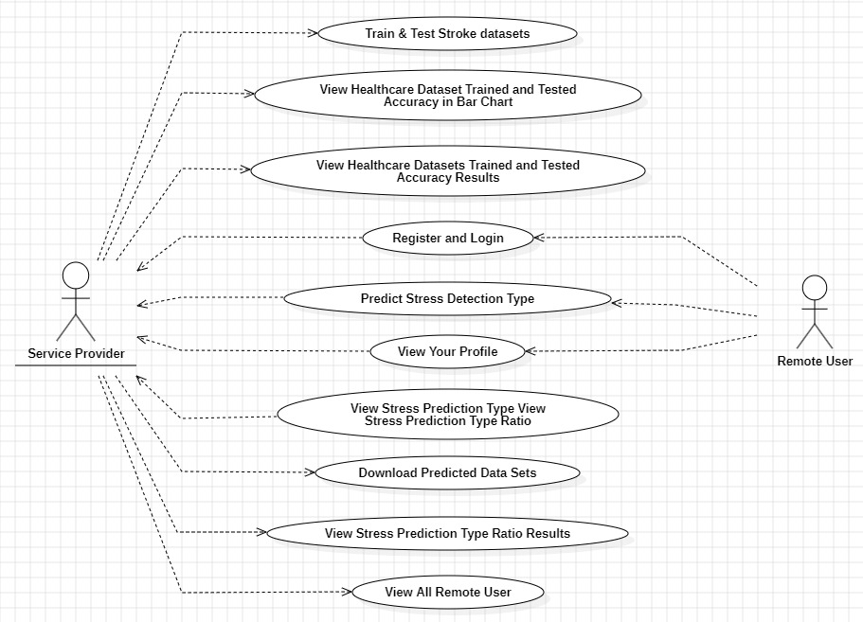
USECASE DIAGRAM

Slide 15
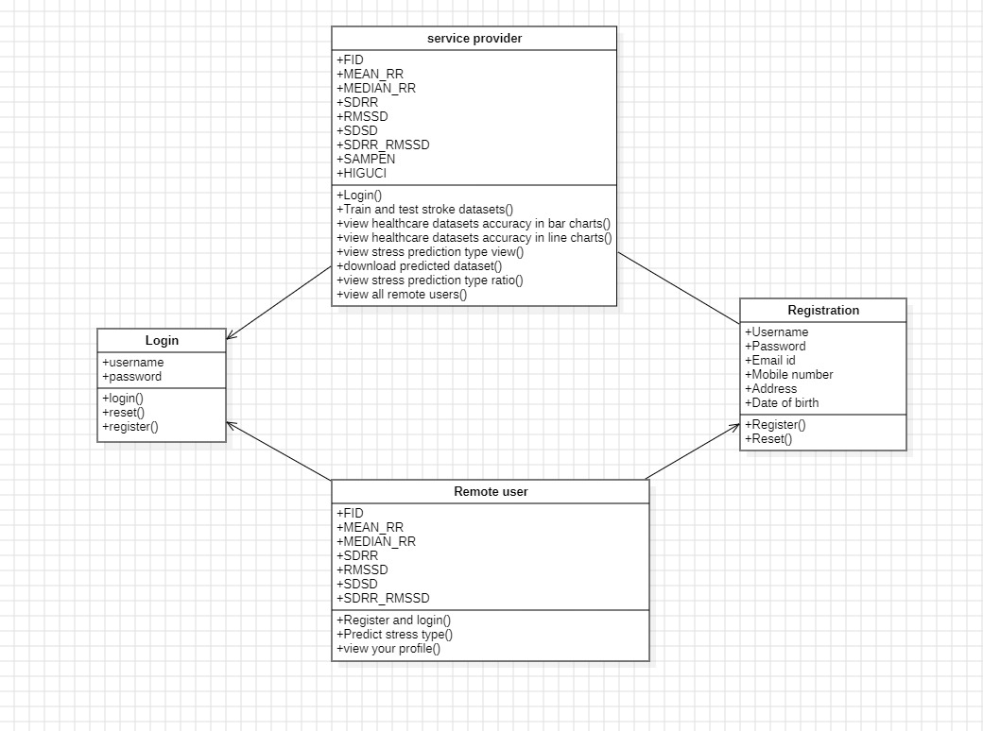
CLASS DIAGRAM

Slide 16
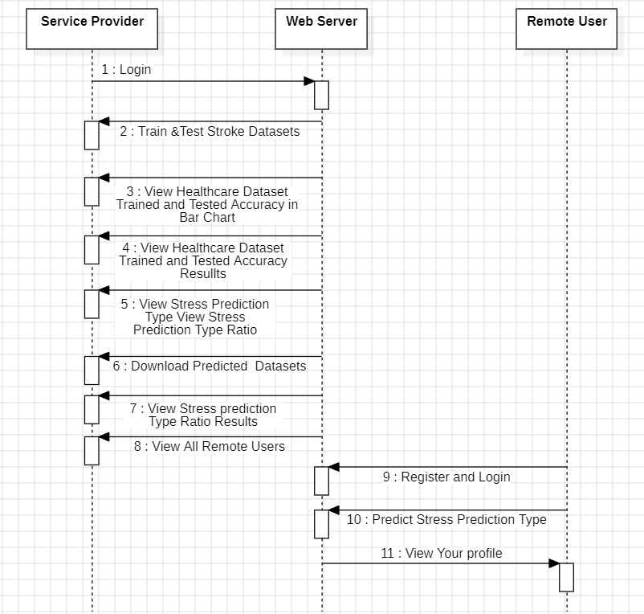
SEQUENCE DIAGRAM

Slide 17
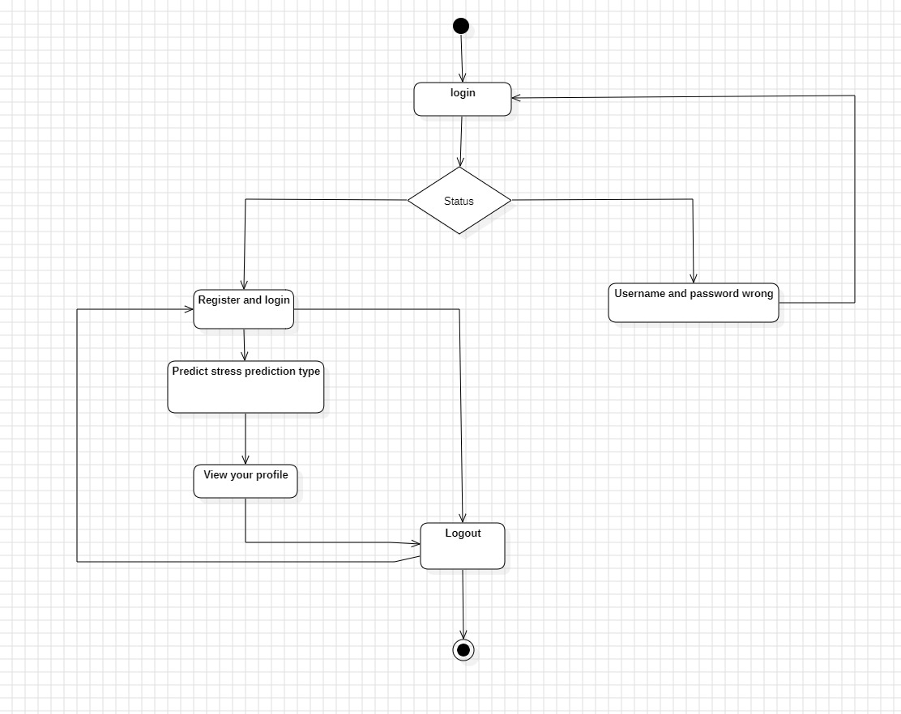
ACTIVITY DIAGRAM

Slide 18
SAMPLE CODE
from django.db.models import Count
from django.db.models import Q
from django.shortcuts import render, redirect, get_object_or_404
import datetime
import openpyxl
import numpy as np # linear algebra
import pandas as pd # data processing, CSV file I/O (e.g. pd.read_csv)
from sklearn.feature_extraction.text import CountVectorizer
from sklearn.tree import DecisionTreeClassifier
from sklearn.ensemble import VotingClassifier
#model selection
from sklearn.metrics import confusion_matrix, accuracy_score, plot_confusion_matrix, classification_report
from Remote_User.models import ClientRegister_Model,predict_stress_detection,detection_ratio,detection_accuracy

Slide 19
def login(request):
if request.method == "POST" and 'submit1' in request.POST:
username = request.POST.get('username')
password = request.POST.get('password')
try:
enter = ClientRegister_Model.objects.get(username=username,password=password)
request.session["userid"] = enter.id
return redirect('ViewYourProfile')
except:
pass
return render(request,'RUser/login.html')
def Add_DataSet_Details(request):
return render(request, 'RUser/Add_DataSet_Details.html', {"excel_data": ''})
def Register1(request):
if request.method == "POST":
username = request.POST.get('username')
email = request.POST.get('email')
password = request.POST.get('password')
phoneno = request.POST.get('phoneno')
country = request.POST.get('country')
state = request.POST.get('state')
city = request.POST.get('city')
address = request.POST.get('address')
gender = request.POST.get('gender')
ClientRegister_Model.objects.create(username=username, email=email, password=password, phoneno=phoneno,
country=country, state=state, city=city, address=address, gender=gender)
obj = "Registered Successfully"
return render(request, 'RUser/Register1.html', {'object': obj})
else:
return render(request,'RUser/Register1.html')

Slide 20
def ViewYourProfile(request):
userid = request.session['userid']
obj = ClientRegister_Model.objects.get(id= userid)
return render(request,'RUser/ViewYourProfile.html',{'object':obj})
def Predict_Stress_Detection(request):
if request.method == "POST":
if request.method == "POST":
FID= request.POST.get('FID')
MEAN_RR= request.POST.get('MEAN_RR')
MEDIAN_RR= request.POST.get('MEDIAN_RR')
SDRR= request.POST.get('SDRR')
RMSSD = request.POST.get('RMSSD')
SDSD= request.POST.get('SDSD')
SDRR_RMSSD= request.POST.get('SDRR_RMSSD')
HR= request.POST.get('HR')
VLF= request.POST.get('VLF')
VLF_PCT= request.POST.get('VLF_PCT')
LF= request.POST.get('LF')
LF_PCT= request.POST.get('LF_PCT')
LF_NU= request.POST.get('LF_NU')
HF= request.POST.get('HF')
HF_PCT= request.POST.get('HF_PCT')
HF_NU= request.POST.get('HF_NU')
TP= request.POST.get('TP')
LF_HF= request.POST.get('LF_HF')
HF_LF= request.POST.get('HF_LF')
sampen= request.POST.get('sampen')
higuci= request.POST.get('higuci')
df = pd.read_csv('Datasets.csv', encoding='latin-1')
def apply_results(label):
if (label == 'no stress'):
return 0 # No Stress
elif (label == 'stress'):
return 1 # Stress

Slide 21
df['results'] = df['condition'].apply(apply_results)
x = df["FID"]
y = df["results"]
cv = CountVectorizer(lowercase=False, strip_accents='unicode', ngram_range=(1, 1))
x = cv.fit_transform(x)
print("Data")
print(x)
print("Results")
print(y)
models = []
from sklearn.model_selection import train_test_split
X_train, X_test, y_train, y_test = train_test_split(x, y, test_size=0.20)
X_train.shape, X_test.shape, y_train.shape
print("Naive Bayes")
from sklearn.naive_bayes import MultinomialNB
NB = MultinomialNB()
NB.fit(X_train, y_train)
predict_nb = NB.predict(X_test)
naivebayes = accuracy_score(y_test, predict_nb) * 100
print(naivebayes)
print(confusion_matrix(y_test, predict_nb))
print(classification_report(y_test, predict_nb))
models.append(('naive_bayes', NB))
# SVM Model
print("SVM")
from sklearn import svm
lin_clf = svm.LinearSVC()
lin_clf.fit(X_train, y_train)
predict_svm = lin_clf.predict(X_test)
svm_acc = accuracy_score(y_test, predict_svm) * 100
print(svm_acc)
print("CLASSIFICATION REPORT")
print(classification_report(y_test, predict_svm))
print("CONFUSION MATRIX")
print(confusion_matrix(y_test, predict_svm))
models.append(('svm', lin_clf))

Slide 22
print("Logistic Regression")
from sklearn.linear_model import LogisticRegression
reg = LogisticRegression(random_state=0, solver='lbfgs').fit(X_train, y_train)
y_pred = reg.predict(X_test)
print("ACCURACY")
print(accuracy_score(y_test, y_pred) * 100)
print("CLASSIFICATION REPORT")
print(classification_report(y_test, y_pred))
print("CONFUSION MATRIX")
print(confusion_matrix(y_test, y_pred))
models.append(('logistic', reg))
print("Decision Tree Classifier")
dtc = DecisionTreeClassifier()
dtc.fit(X_train, y_train)
dtcpredict = dtc.predict(X_test)
print("ACCURACY")
print(accuracy_score(y_test, dtcpredict) * 100)
print("CLASSIFICATION REPORT")
print(classification_report(y_test, dtcpredict))
print("CONFUSION MATRIX")
print(confusion_matrix(y_test, dtcpredict))
classifier = VotingClassifier(models)
classifier.fit(X_train, y_train)
y_pred = classifier.predict(X_test)
FID1 = [FID]
vector1 = cv.transform(FID1).toarray()
predict_text = classifier.predict(vector1)
pred = str(predict_text).replace("[", "")
pred1 = pred.replace("]", "")
prediction = int(pred1)
if prediction == 0:
val = 'No Stress'
elif prediction == 1:
val = 'Stress'
print(prediction)
print(val)

Slide 23
predict_stress_detection.objects.create(
FID=FID,
MEAN_RR=MEAN_RR,
MEDIAN_RR=MEDIAN_RR,
SDRR=SDRR,
RMSSD=RMSSD,
SDSD=SDSD,
SDRR_RMSSD=SDRR_RMSSD,
HR=HR,
VLF=VLF,
VLF_PCT=VLF_PCT,
LF=LF,
LF_PCT=LF_PCT,
LF_NU=LF_NU,
HF=HF,
HF_PCT=HF_PCT,
HF_NU=HF_NU,
TP=TP,
LF_HF=LF_HF,
HF_LF=HF_LF,
sampen=sampen,
higuci=higuci,
Prediction=val)
return render(request, 'RUser/Predict_Stress_Detection.html',{'objs': val})
return render(request, 'RUser/Predict_Stress_Detection.html')

Slide 24
from django.db.models import Count, Avg
from django.shortcuts import render, redirect
from django.db.models import Count
from django.db.models import Q
import datetime
import xlwt
from django.http import HttpResponse
import numpy as np
import numpy as np # linear algebra
import pandas as pd # data processing, CSV file I/O (e.g. pd.read_csv)
from sklearn.feature_extraction.text import CountVectorizer
from sklearn.tree import DecisionTreeClassifier
#model selection
from sklearn.metrics import confusion_matrix, accuracy_score, plot_confusion_matrix, classification_report
# Create your views here.
from Remote_User.models import ClientRegister_Model,predict_stress_detection,detection_ratio,detection_accuracy
def serviceproviderlogin(request):
if request.method == "POST":
admin = request.POST.get('username')
password = request.POST.get('password')
if admin == "Admin" and password =="Admin":
detection_accuracy.objects.all().delete()
return redirect('View_Remote_Users')
return render(request,'SProvider/serviceproviderlogin.html')

Slide 25
def View_Predict_Stress_Detection_Type_Ratio(request):
detection_ratio.objects.all().delete()
rratio = ""
kword = 'Stress'
print(kword)
obj = predict_stress_detection.objects.all().filter(Q(Prediction=kword))
obj1 = predict_stress_detection.objects.all()
count = obj.count();
count1 = obj1.count();
ratio = (count / count1) * 100
if ratio != 0:
detection_ratio.objects.create(names=kword, ratio=ratio)
ratio1 = ""
kword1 = 'No Stress'
print(kword1)
obj1 = predict_stress_detection.objects.all().filter(Q(Prediction=kword1))
obj11 = predict_stress_detection.objects.all()
count1 = obj1.count();
count11 = obj11.count();
ratio1 = (count1 / count11) * 100
if ratio1 != 0:
detection_ratio.objects.create(names=kword1, ratio=ratio1)
obj = detection_ratio.objects.all()
return render(request, 'SProvider/View_Predict_Stress_Detection_Type_Ratio.html', {'objs': obj})
def View_Remote_Users(request):
obj=ClientRegister_Model.objects.all()
return render(request,'SProvider/View_Remote_Users.html',{'objects':obj})

Slide 26
def ViewTrendings(request):
topic = predict_stress_detection.objects.values('topics').annotate(dcount=Count('topics')).order_by('-dcount')
return render(request,'SProvider/ViewTrendings.html',{'objects':topic})
def charts(request,chart_type):
chart1 = detection_ratio.objects.values('names').annotate(dcount=Avg('ratio'))
return render(request,"SProvider/charts.html", {'form':chart1, 'chart_type':chart_type})
def charts1(request,chart_type):
chart1 = detection_accuracy.objects.values('names').annotate(dcount=Avg('ratio'))
return render(request,"SProvider/charts1.html", {'form':chart1, 'chart_type':chart_type})
def View_Predict_Stress_Detection_Details(request):
obj =predict_stress_detection.objects.all()
return render(request, 'SProvider/View_Predict_Stress_Detection_Details.html', {'list_objects': obj})
def likeschart(request,like_chart):
charts =detection_accuracy.objects.values('names').annotate(dcount=Avg('ratio'))
return render(request,"SProvider/likeschart.html", {'form':charts, 'like_chart':like_chart})
def Download_Trained_DataSets(request):
response = HttpResponse(content_type='application/ms-excel')
# decide file name
response['Content-Disposition'] = 'attachment; filename="Predicted_Data.xls"'
# creating workbook
wb = xlwt.Workbook(encoding='utf-8')
# adding sheet
ws = wb.add_sheet("sheet1")
# Sheet header, first row
row_num = 0
font_style = xlwt.XFStyle()
# headers are bold
font_style.font.bold = True
# writer = csv.writer(response)
obj = predict_stress_detection.objects.all()
data = obj # dummy method to fetch data.

Slide 27
for my_row in data:
row_num = row_num + 1
ws.write(row_num, 0, my_row.FID, font_style)
ws.write(row_num, 1, my_row.MEAN_RR, font_style)
ws.write(row_num, 2, my_row.MEDIAN_RR, font_style)
ws.write(row_num, 3, my_row.SDRR, font_style)
ws.write(row_num, 4, my_row.RMSSD, font_style)
ws.write(row_num, 5, my_row.SDSD, font_style)
ws.write(row_num, 6, my_row.SDRR_RMSSD, font_style)
ws.write(row_num, 7, my_row.HR, font_style)
ws.write(row_num, 8, my_row.VLF, font_style)
ws.write(row_num, 9, my_row.VLF_PCT, font_style)
ws.write(row_num, 10, my_row.LF, font_style)
ws.write(row_num, 11, my_row.LF_PCT, font_style)
ws.write(row_num, 12, my_row.LF_NU, font_style)
ws.write(row_num, 13, my_row.HF, font_style)
ws.write(row_num, 14, my_row.HF_PCT, font_style)
ws.write(row_num, 15, my_row.HF_NU, font_style)
ws.write(row_num, 16, my_row.TP, font_style)
ws.write(row_num, 17, my_row.LF_HF, font_style)
ws.write(row_num, 18, my_row.HF_LF, font_style)
ws.write(row_num, 19, my_row.sampen, font_style)
ws.write(row_num, 20, my_row.higuci, font_style)
ws.write(row_num, 21, my_row.Prediction, font_style)
wb.save(response)
return response

Slide 28
def train_model(request):
detection_accuracy.objects.all().delete()
df = pd.read_csv('Datasets.csv', encoding='latin-1')
def apply_results(label):
if (label == 'no stress'):
return 0 # No Stress
elif (label == 'stress'):
return 1 # Stress
df['results'] = df['condition'].apply(apply_results)
x = df["FID"]
y = df["results"]
cv = CountVectorizer(lowercase=False, strip_accents='unicode', ngram_range=(1, 1))
x = cv.fit_transform(x)
#x = cv.fit_transform(x.apply(lambda x: np.str_(x)))
labeled = 'Results_data.csv'
df.to_csv(labeled, index=False)
df.to_markdown
print("Data")
print(x)
print("Results")
print(y)
models = []
from sklearn.model_selection import train_test_split
X_train, X_test, y_train, y_test = train_test_split(x, y, test_size=0.30, random_state=123)
X_train.shape, X_test.shape, y_train.shape
print("Convolution Neural Network (CNN)")
from sklearn.neural_network import MLPClassifier
mlpc = MLPClassifier().fit(X_train, y_train)
y_pred = mlpc.predict(X_test)
print("ACCURACY")
print(accuracy_score(y_test, y_pred) * 100)

Slide 29
print("CLASSIFICATION REPORT")
print(classification_report(y_test, y_pred))
print("CONFUSION MATRIX")
print(confusion_matrix(y_test, y_pred))
models.append(('MLPClassifier', mlpc))
detection_accuracy.objects.create(names="Convolution Neural Network (CNN)",ratio=accuracy_score(y_test, y_pred) * 100)
# SVM Model
print("SVM")
from sklearn import svm
lin_clf = svm.LinearSVC()
lin_clf.fit(X_train, y_train)
predict_svm = lin_clf.predict(X_test)
svm_acc = accuracy_score(y_test, predict_svm) * 100
print("ACCURACY")
print(svm_acc)
print("CLASSIFICATION REPORT")
print(classification_report(y_test, predict_svm))
print("CONFUSION MATRIX")
print(confusion_matrix(y_test, predict_svm))
detection_accuracy.objects.create(names="SVM", ratio=svm_acc)
print("Logistic Regression")
from sklearn.linear_model import LogisticRegression
reg = LogisticRegression(random_state=0, solver='lbfgs').fit(X_train, y_train)
y_pred = reg.predict(X_test)
print("ACCURACY")
print(accuracy_score(y_test, y_pred) * 100)
print("CLASSIFICATION REPORT")
print(classification_report(y_test, y_pred))

Slide 30
print("CONFUSION MATRIX")
print(confusion_matrix(y_test, y_pred))
detection_accuracy.objects.create(names="Logistic Regression", ratio=accuracy_score(y_test, y_pred) * 100)
print("Decision Tree Classifier")
dtc = DecisionTreeClassifier()
dtc.fit(X_train, y_train)
dtcpredict = dtc.predict(X_test)
print("ACCURACY")
print(accuracy_score(y_test, dtcpredict) * 100)
print("CLASSIFICATION REPORT")
print(classification_report(y_test, dtcpredict))
print("CONFUSION MATRIX")
print(confusion_matrix(y_test, dtcpredict))
detection_accuracy.objects.create(names="Decision Tree Classifier", ratio=accuracy_score(y_test, dtcpredict) * 100)
labeled = 'Results_data.csv'
df.to_csv(labeled, index=False)
df.to_markdown
obj = detection_accuracy.objects.all()
return render(request,'SProvider/train_model.html', {'objs': obj})

Slide 31
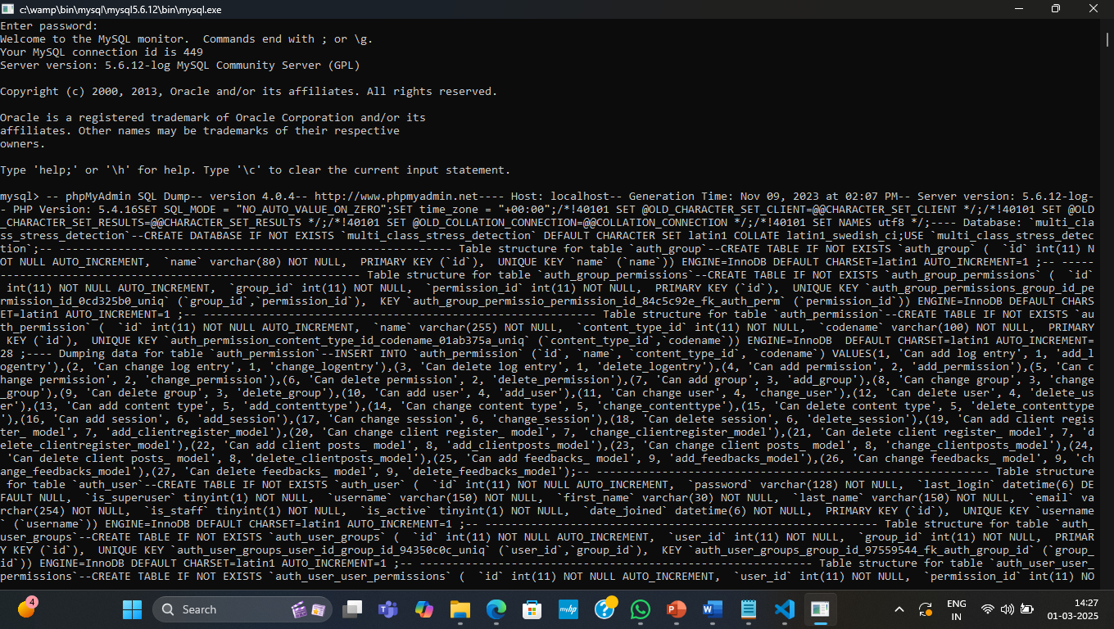
RESULTS
Screenshot 1:Start wampserver and open MYSQL console and dump the sql code into it.

Slide 32
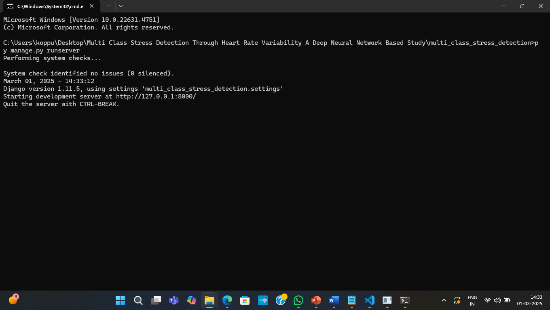
Screenshot 2: The Python server has started. Open a web browser, enter http://127.0.0.1:8000 and press Enter. The application page will load as shown below

Slide 33

Screenshot 3: Click on the ‘Register’ link to open the registration page shown below.

Slide 34
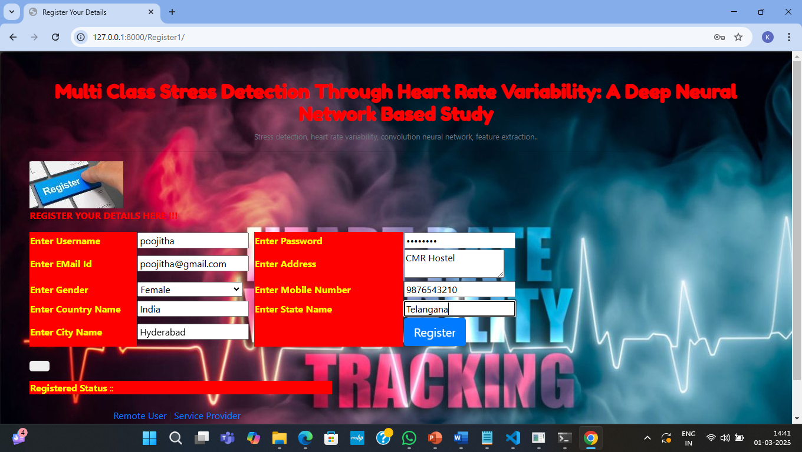
Screenshot 4: Enter the user details for sign-up and press the register button to proceed to the next page.

Slide 35

Screenshot 5: Enter remote user details to login into the following page.

Slide 36
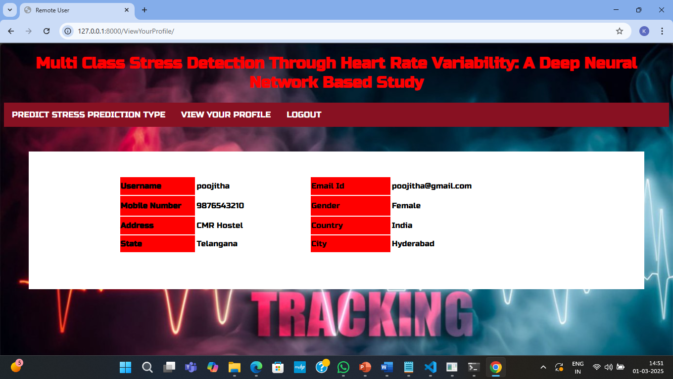
Screenshot 6: The user’s profile can be viewed after logging in.

Slide 37
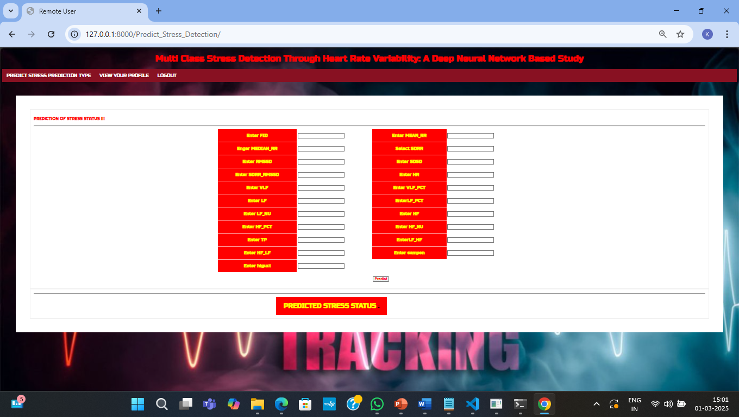
Screenshot 7: click predict stress prediction type option and the above page opens.

Slide 38
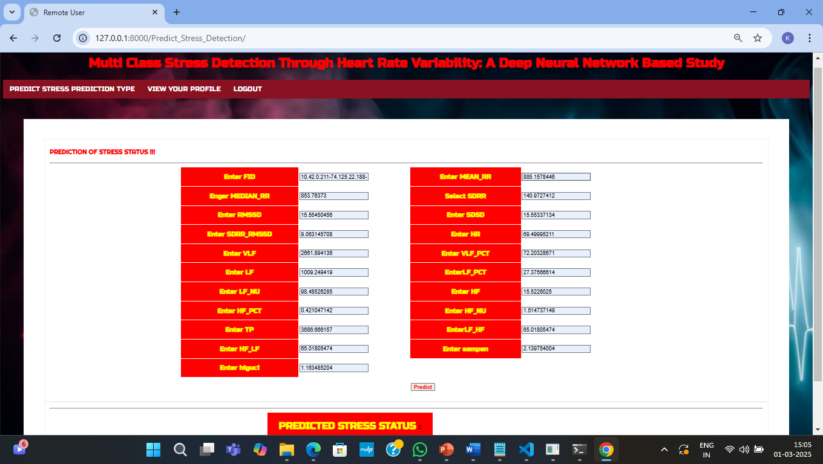
Screenshot 8: Enter all the values and click on predict to classify as stress and no stress.

Slide 39

Screenshot 9: Click on service provider in home page and login using admin details.

Slide 40
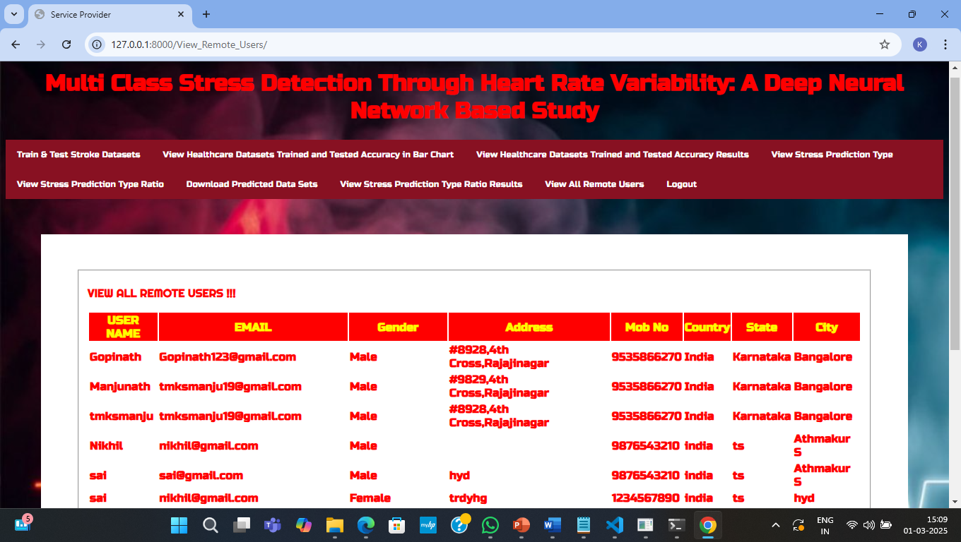
Screenshot 10: All the remote users can be viewed in service provider login.

Slide 41
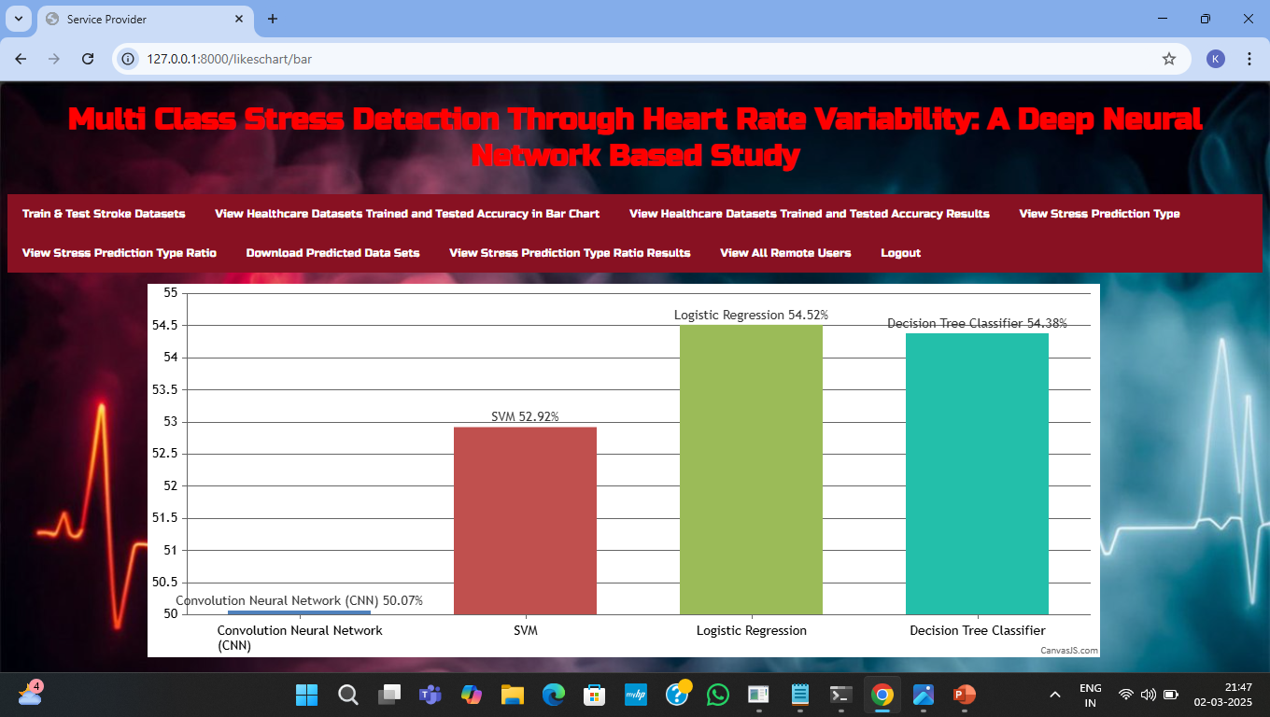
Screenshot 11: representation of accuracy using different algorithms in bargraph.

Slide 42
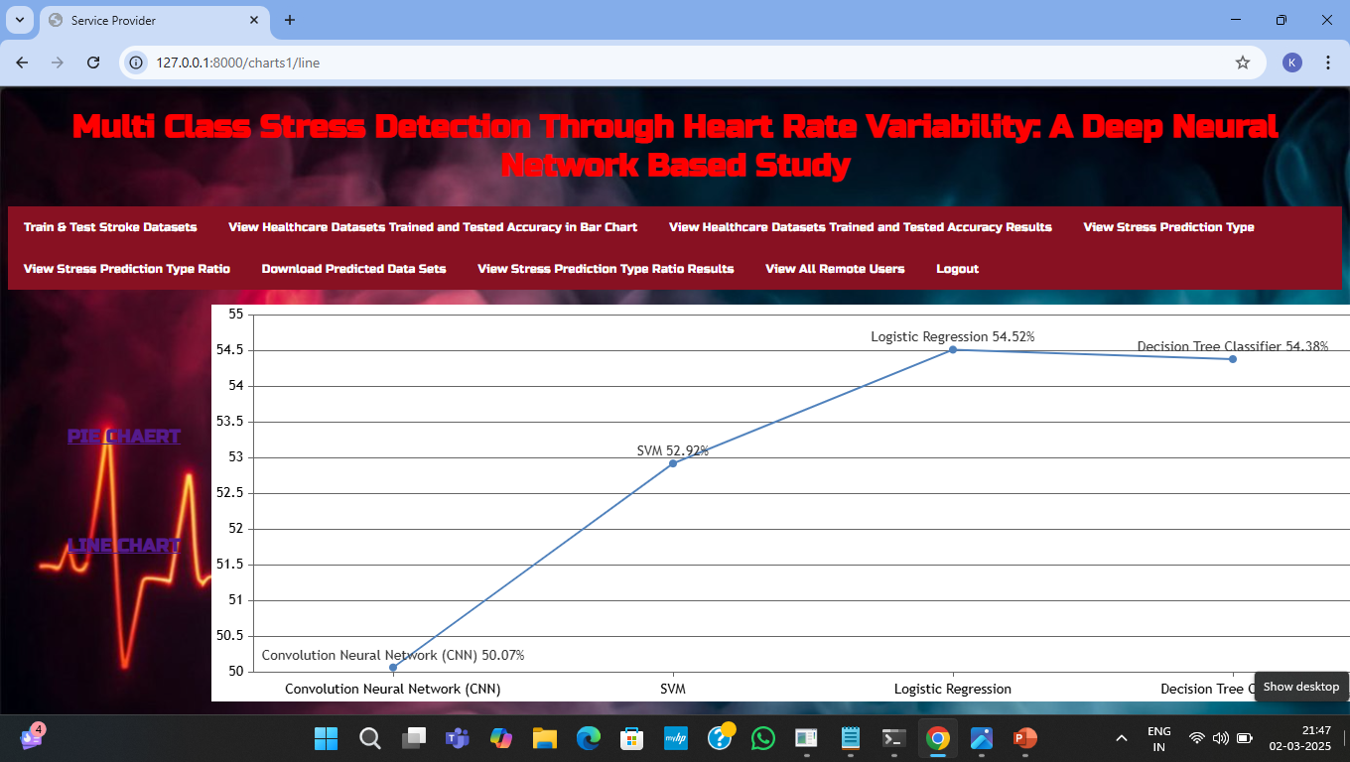
Screenshot 12: representation of accuracy using different algorithms in linechart.

Slide 43
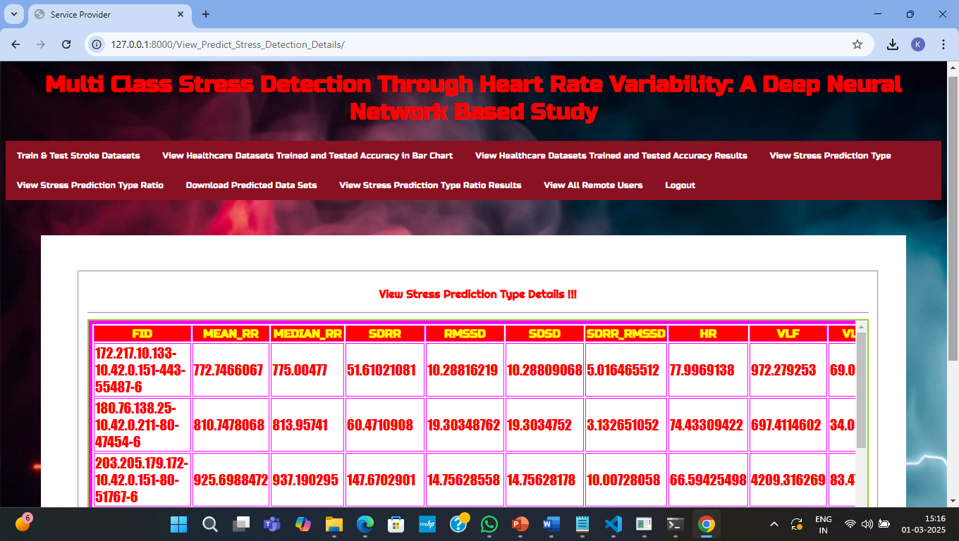
Screenshot 13: All the previously predicted details can be viewed here.

Slide 44
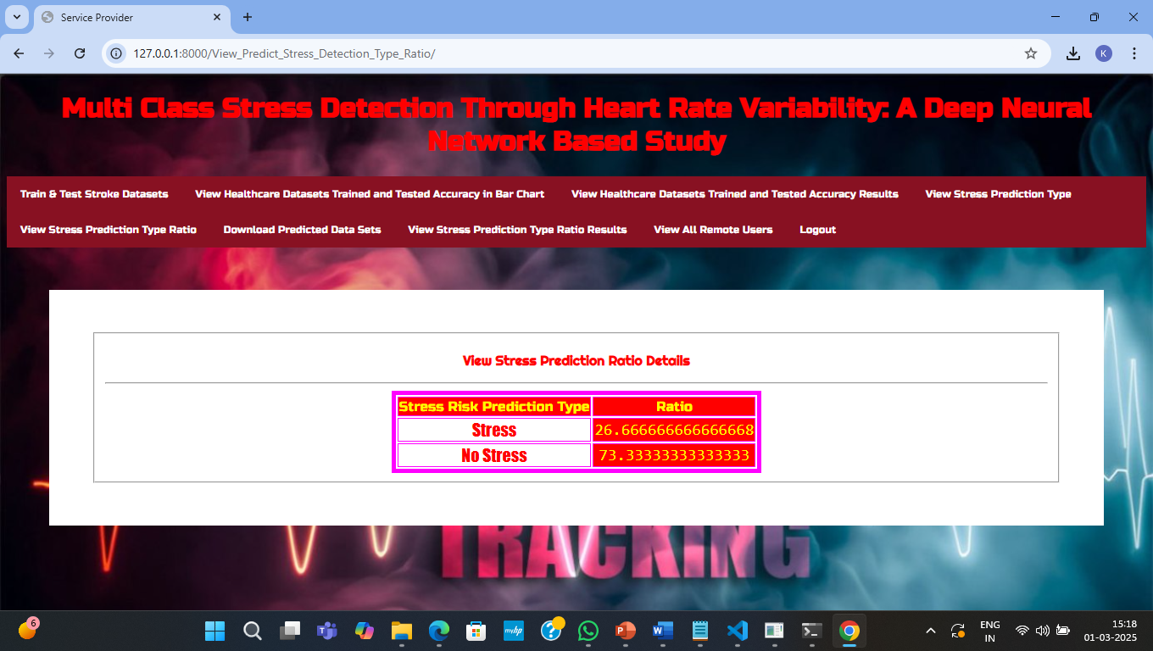
Screenshot 14: Stress vs No stress ratio.

Slide 45
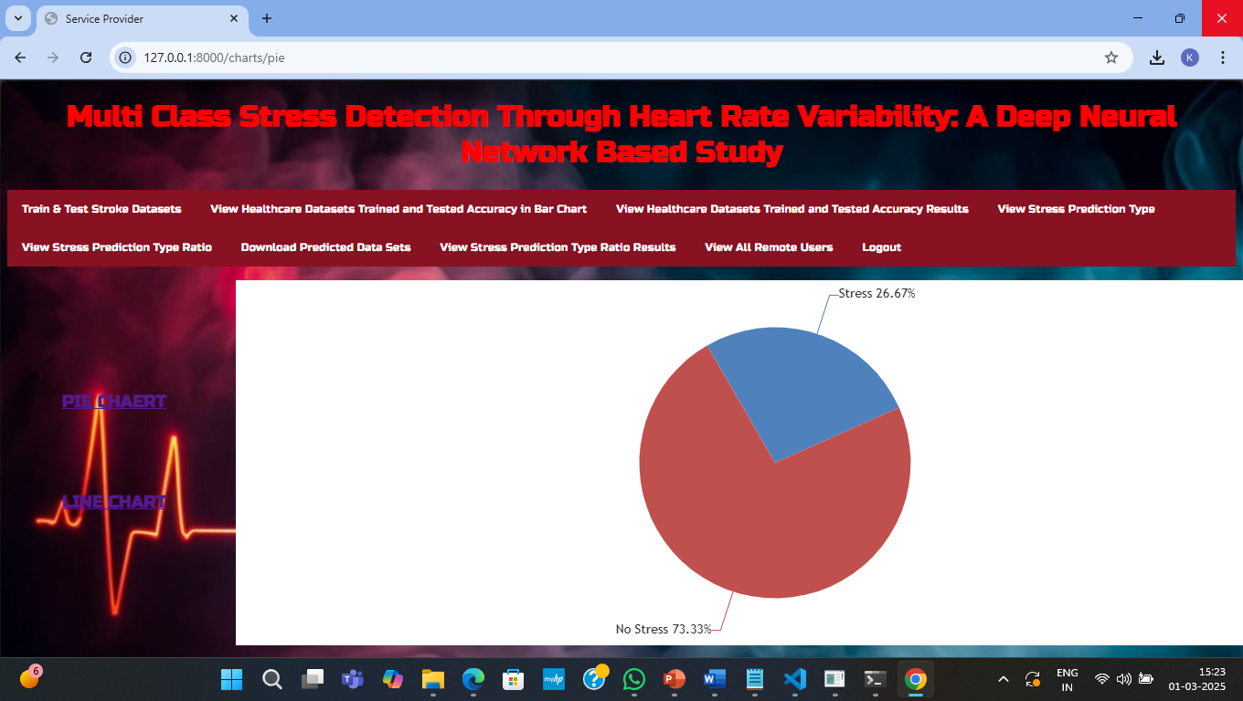
Screenshot 15: Stress vs No stress ratio representation in piechart.

Slide 46
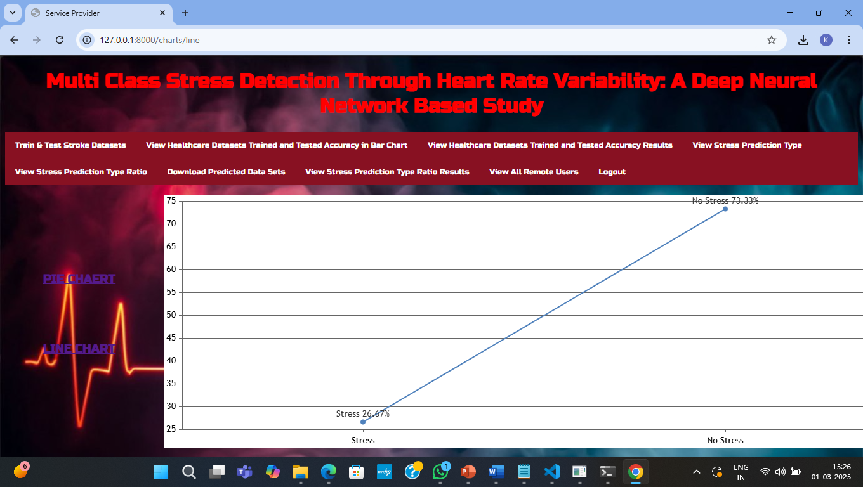
Screenshot 16: Stress vs No stress ratio representation in linechart.

Slide 47
CONCLUSION
We have developed a model for stress classification using HRV features and validated the proposed model based on a publicly available dataset, SWELL−KW.
Through extensive training and validation, we demonstrate that our model outperforms the state-of-the-art models in terms of major performance metrics, i.e., Accuracy, Precision, Recall, F1-score, and MCC when all features are employed.
Furthermore, we plan to further investigate the feasibility of optimizing the model to fit it into edge devices so that real-time stress detection can become a reality.

Slide 48
FUTURE SCOPE
Continuous HRV Monitoring with Wearables
Smartwatches, fitness bands, and ECG patches enable real-time HRV tracking.
Advanced signal processing techniques filter noise for accurate stress detection.
Edge Computing for On-device Analysis
Local processing of HRV data reduces latency and cloud dependency.
AI-powered models run directly on wearables for real-time stress classification.
Energy-efficient & Adaptive Stress Detection
Optimized, low-power AI models ensure efficient processing on wearable devices.
Personalized stress thresholds adapt based on individual HRV patterns.
Integration with Health & Telemedicine Platforms
Syncing with mobile health apps for visualization and stress management.
Remote monitoring capabilities for healthcare professionals via secure cloud systems

Slide 49
REFERENCES
H.-G. Kim, E.-J. Cheon, D.-S. Bai, Y. H. Lee, and B.-H. Koo, ‘‘Stress and heart rate variability: A meta-analysis and review of the literature,’’Psychiatry Invest., vol. 15, no. 3, pp. 235–245, Mar. 2018.
D. Muhajir, F. Mahananto, and N. A. Sani, ‘‘Stress level measurements using heart rate variability analysis on Android based application,’’ Proc.Comput. Sci., vol. 197, pp. 189–197, Jan. 2022.
J. Held, A. Vîslă, C. Wolfer, N. Messerli-Bürgy, and C. Flückiger, ‘‘Heartrate variability change during a stressful cognitive task in individuals with anxiety and control participants,’’ BMC Psychol., vol. 9, no. 1, p. 44,Mar. 2021.
K. M. Dalmeida and G. L. Masala, ‘‘HRV features as viable physiological markers for stress detection using wearable devices,’’ Sensors, vol. 21, no. 8, p. 2873, Apr. 2021.
J. A. Miranda-Correa, M. K. Abadi, N. Sebe, and I. Patras, ‘‘AMIGOS: A dataset for affect, personality and mood research on individuals and groups,’’ IEEE Trans. Affect. Comput., vol. 12, no. 2, pp. 479–493, Apr./Jun. 2021.
E. Won and Y.-K. Kim, ‘‘Stress, the autonomic nervous system, and the immune-kynurenine pathway in the etiology of depression,’’ Current Neuropharmacol., vol. 14, no. 7, pp. 665–673, Aug. 2016.

Slide 50


